Slide 1
Basic Concepts of MySQL and MongoDB
(15 hours)
Notes:
Title - The learning outcome
Subtitle - Duration

Slide 2
In this section, we will discuss:
Unstructured databases
Structured vs unstructured data
MongoDB fundamentals
MongoDB documents, databases, records
MongoDB Atlas cluster
MongoDB Atlas cluster connection and access remotely
Notes:
Mention the parent topics one by one. This particular learning outcome has 4 parent topics.

Slide 3
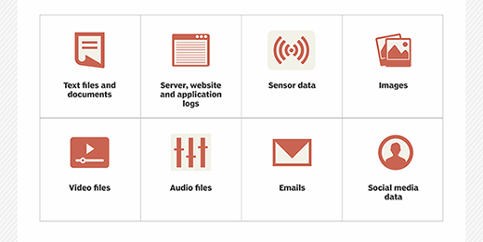
Unstructured databases
What is Unstructured Data?
Unstructured data, typically categorized as qualitative data, cannot be processed and analyzed via conventional data tools and methods.
Image Source: https://cdn.ttgtmedia.com/rms/onlineImages/business_analytics-unstructured_data_mobile.png
Notes:
Left (White Color space):
Title - Parent Topic
Subtitle - Subtopic 1
Body Text - Description in bullets
Right (Grey Color Space):
Body Text - Relevant image (with source)/code snippet
Put reference links in Speaker Notes
Reference:
https://www.tutorialspoint.com/internet_technologies/internet_overview.htm/

Slide 4
Unstructured databases
Characteristics of Unstructured Data:
Data neither conforms to a data model nor has any structure.
Data cannot be stored in the form of rows and columns as in Databases
Data does not follow any semantic or rules
Image Source: https://cdn.ttgtmedia.com/rms/onlineImages/business_analytics-unstructured_data_mobile.png
Notes:
Left (White Color space):
Title - Parent Topic
Subtitle - Subtopic 1
Body Text - Description in bullets
Right (Grey Color Space):
Body Text - Relevant image (with source)/code snippet
Put reference links in Speaker Notes
Reference:
https://www.tutorialspoint.com/internet_technologies/internet_overview.htm/

Slide 5
Unstructured databases
Characteristics of Unstructured Data:
Data lacks any particular format or sequence
Data has no easily identifiable structure
Due to lack of identifiable structure, it cannot used by computer programs easily
Image Source: https://cdn.ttgtmedia.com/rms/onlineImages/business_analytics-unstructured_data_mobile.png
Notes:
Left (White Color space):
Title - Parent Topic
Subtitle - Subtopic 1
Body Text - Description in bullets
Right (Grey Color Space):
Body Text - Relevant image (with source)/code snippet
Put reference links in Speaker Notes
Reference:
https://www.tutorialspoint.com/internet_technologies/internet_overview.htm/

Slide 6
Unstructured databases
Pros and Cons of unstructured data
Pros
Native format
Fast accumulation rates
Data lake storage
Image Source: https://cdn.ttgtmedia.com/rms/onlineImages/business_analytics-unstructured_data_mobile.png
Notes:
Left (White Color space):
Title - Parent Topic
Subtitle - Subtopic 1
Body Text - Description in bullets
Right (Grey Color Space):
Body Text - Relevant image (with source)/code snippet
Put reference links in Speaker Notes
Reference:
https://www.tutorialspoint.com/internet_technologies/internet_overview.htm/

Slide 7
Unstructured databases
Pros and Cons of unstructured data
Cons
Requires expertise
Specialized tools
Image Source: https://cdn.ttgtmedia.com/rms/onlineImages/business_analytics-unstructured_data_mobile.png
Notes:
Left (White Color space):
Title - Parent Topic
Subtitle - Subtopic 1
Body Text - Description in bullets
Right (Grey Color Space):
Body Text - Relevant image (with source)/code snippet
Put reference links in Speaker Notes
Reference:
https://www.tutorialspoint.com/internet_technologies/internet_overview.htm/

Slide 8
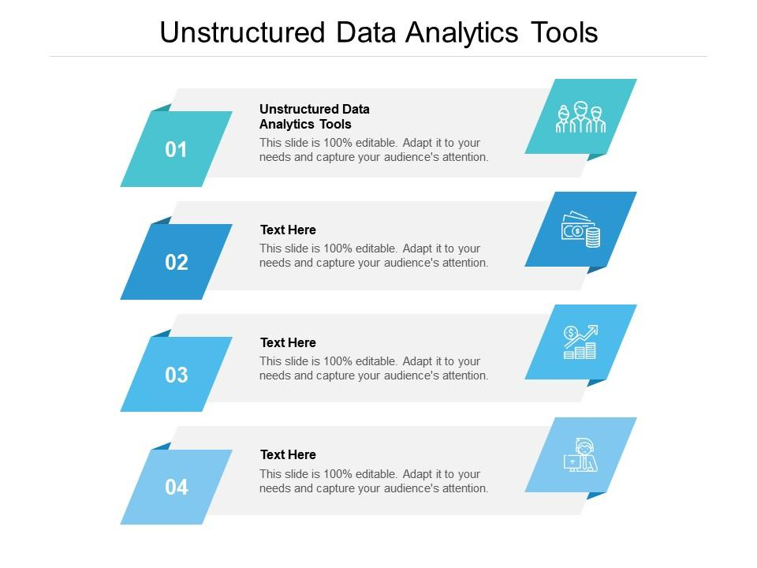
Unstructured databases
Unstructured data tools
Data mining
Predictive data analytics
Chatbots
Image Source:https://www.slideteam.net/media/catalog/product/cache/1280x720/u/n/unstructured_data_analytics_tools_ppt_powerpoint_presentation_summary_tips_cpb_slide01.jpg
Notes:
Left (White Color space):
Title - Parent Topic
Subtitle - Subtopic 1
Body Text - Description in bullets
Right (Grey Color Space):
Body Text - Relevant image (with source)/code snippet
Put reference links in Speaker Notes
Reference:
https://www.tutorialspoint.com/internet_technologies/internet_overview.htm/

Slide 9
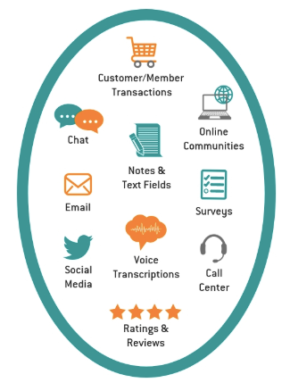
Unstructured databases
Examples of unstructured data
Here are some examples of the human-generated variety
Email
Text files
Social media and websites
Mobile and communications data
Media
Image Source:https://wiki.atlan.com/content/images/2019/10/Unstructured-data-examples.png
Notes:
Left (White Color space):
Title - Parent Topic
Subtitle - Subtopic 1
Body Text - Description in bullets
Right (Grey Color Space):
Body Text - Relevant image (with source)/code snippet
Put reference links in Speaker Notes
Reference:
https://www.tutorialspoint.com/internet_technologies/internet_overview.htm/

Slide 10
Unstructured databases
Examples of unstructured data
Here are some examples of unstructured data generated by machines
Scientific data
Digital surveillance
Satellite imagery
Image Source:https://wiki.atlan.com/content/images/2019/10/Unstructured-data-examples.png
Notes:
Left (White Color space):
Title - Parent Topic
Subtitle - Subtopic 1
Body Text - Description in bullets
Right (Grey Color Space):
Body Text - Relevant image (with source)/code snippet
Put reference links in Speaker Notes
Reference:
https://www.tutorialspoint.com/internet_technologies/internet_overview.htm/

Slide 11
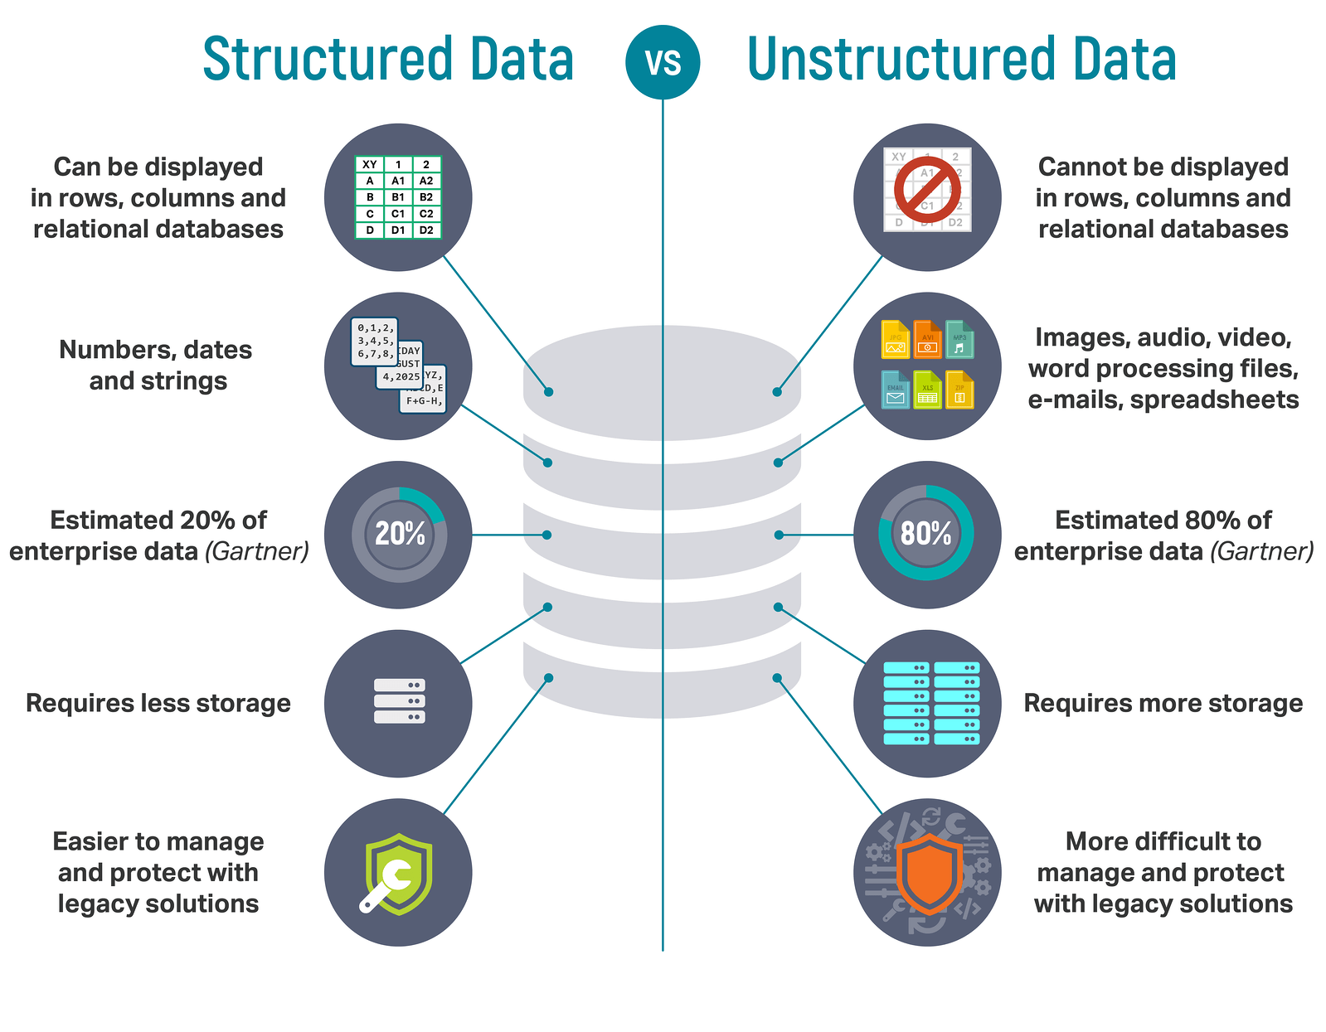
Structured vs unstructured data
Key characteristics
With structured data, every record adheres to a predefined data model; if incoming data fails to meet those definitions, it cannot be saved without correction or truncation.
Unstructured data is more ambiguous. Without a predefined data model, you can store a far broader range of rich data including images, sound, video, and text.
Image Source: https://lawtomated.com/wp-content/uploads/2019/04/structuredVsUnstructuredIgneos.png
Notes:
Left (White Color space):
Title - Parent Topic
Subtitle - Subtopic 1
Body Text - Description in bullets
Right (Grey Color Space):
Body Text - Relevant image (with source)/code snippet
Put reference links in Speaker Notes
Reference:
https://www.tutorialspoint.com/internet_technologies/internet_overview.htm/

Slide 12
Structured vs unstructured data
Data storage options
Structured data is well suited to the relative limitations of relational database systems.
Large data estates can be housed in a data Unstructured data can be, and is, stored in a number of places.
Image Source: https://lawtomated.com/wp-content/uploads/2019/04/structuredVsUnstructuredIgneos.png
Notes:
Left (White Color space):
Title - Parent Topic
Subtitle - Subtopic 1
Body Text - Description in bullets
Right (Grey Color Space):
Body Text - Relevant image (with source)/code snippet
Put reference links in Speaker Notes
Reference:
https://www.tutorialspoint.com/internet_technologies/internet_overview.htm/

Slide 13
Structured vs unstructured data
Where does the data come from?
Structured data is best suited to process-driven applications that rely on specific information presented in a known, consistent format.
Unstructured data and applications powered by unstructured data tend to be more ambiguous; email clients that store messages of varying lengths that may include attachments.
Image Source: https://lawtomated.com/wp-content/uploads/2019/04/structuredVsUnstructuredIgneos.png
Notes:
Left (White Color space):
Title - Parent Topic
Subtitle - Subtopic 1
Body Text - Description in bullets
Right (Grey Color Space):
Body Text - Relevant image (with source)/code snippet
Put reference links in Speaker Notes
Reference:
https://www.tutorialspoint.com/internet_technologies/internet_overview.htm/

Slide 14
Structured vs unstructured data
Extracting value
The linear, controlled nature of structured data is best suited to statistical-type big data analytics using similarly structured query language (SQL).
Unstructured data can also generate these insights and a lot more. Going beyond raw statistics, unstructured data can provide more advanced insights, like customer sentiment.
Image Source: https://lawtomated.com/wp-content/uploads/2019/04/structuredVsUnstructuredIgneos.png
Notes:
Left (White Color space):
Title - Parent Topic
Subtitle - Subtopic 1
Body Text - Description in bullets
Right (Grey Color Space):
Body Text - Relevant image (with source)/code snippet
Put reference links in Speaker Notes
Reference:
https://www.tutorialspoint.com/internet_technologies/internet_overview.htm/

Slide 15
Structured vs unstructured data
Extracting value
The linear, controlled nature of structured data is best suited to statistical-type big data analytics using similarly structured query language (SQL).
Unstructured data can also generate these insights and a lot more. Going beyond raw statistics, unstructured data can provide more advanced insights, like customer sentiment.
Image Source: https://lawtomated.com/wp-content/uploads/2019/04/structuredVsUnstructuredIgneos.png
Notes:
Left (White Color space):
Title - Parent Topic
Subtitle - Subtopic 1
Body Text - Description in bullets
Right (Grey Color Space):
Body Text - Relevant image (with source)/code snippet
Put reference links in Speaker Notes
Reference:
https://www.tutorialspoint.com/internet_technologies/internet_overview.htm/

Slide 16
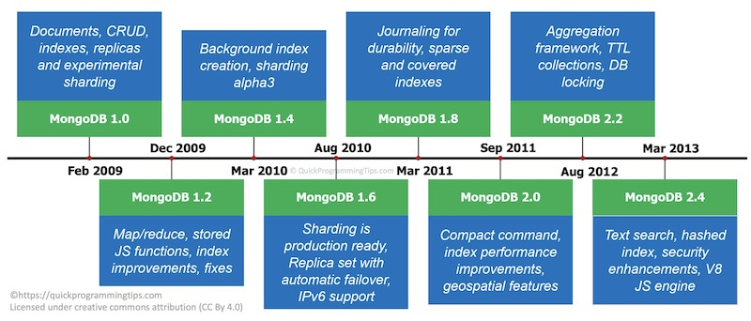
MongoDB fundamentals
Brief History of MongoDB
MongoDB was developed by Eliot Horowitz and Dwight Merriman in the year 2007.
In 2009, MongoDB was made as an open source project, while the company offered commercial support services.
In 2013, the company was officially named MongoDB Inc.
Image Source: https://www.quickprogrammingtips.com/wp-content/uploads/2020/08/mongodb-timeline1.jpg
Notes:
Left (White Color space):
Title - Parent Topic
Subtitle - Subtopic 1
Body Text - Description in bullets
Right (Grey Color Space):
Body Text - Relevant image (with source)/code snippet
Put reference links in Speaker Notes
Reference:
https://www.tutorialspoint.com/internet_technologies/internet_overview.htm/

Slide 17
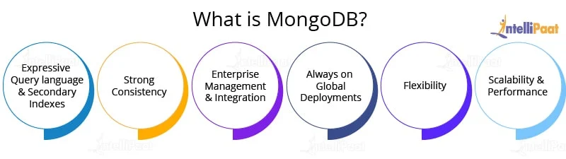
MongoDB fundamentals
What is MongoDB
MongoDB is a cross-platform, document-oriented database that provides, high performance, high availability, and easy scalability. MongoDB works on concept of collection and document.
Image Source: https://intellipaat.com/blog/wp-content/uploads/2015/08/img-1.jpg
Notes:
Left (White Color space):
Title - Parent Topic
Subtitle - Subtopic 1
Body Text - Description in bullets
Right (Grey Color Space):
Body Text - Relevant image (with source)/code snippet
Put reference links in Speaker Notes
Reference:
https://www.tutorialspoint.com/internet_technologies/internet_overview.htm/

Slide 18
MongoDB fundamentals
What is MongoDB
Database
Collection
Document
Image Source: https://intellipaat.com/blog/wp-content/uploads/2015/08/img-1.jpg
Notes:
Left (White Color space):
Title - Parent Topic
Subtitle - Subtopic 1
Body Text - Description in bullets
Right (Grey Color Space):
Body Text - Relevant image (with source)/code snippet
Put reference links in Speaker Notes
Reference:
https://www.tutorialspoint.com/internet_technologies/internet_overview.htm/

Slide 19
MongoDB fundamentals
RDBMS | MongoDB
Database | Database
Table | Collection
Tuple/Row | Document
column | Field
Table Join | Embedded Documents
Primary Key | Primary Key (Default key _id provided by MongoDB itself)
Database Server and Client
mysqld/Oracle | mongod
mysql/sqlplus | mongo
What is MongoDB
The following table shows the relationship of RDBMS terminology with MongoDB.
Notes:
Left (White Color space):
Title - Parent Topic
Subtitle - Subtopic 1
Body Text - Description in bullets
Right (Grey Color Space):
Body Text - Relevant image (with source)/code snippet
Put reference links in Speaker Notes
Reference:
https://www.tutorialspoint.com/internet_technologies/internet_overview.htm/

Slide 20
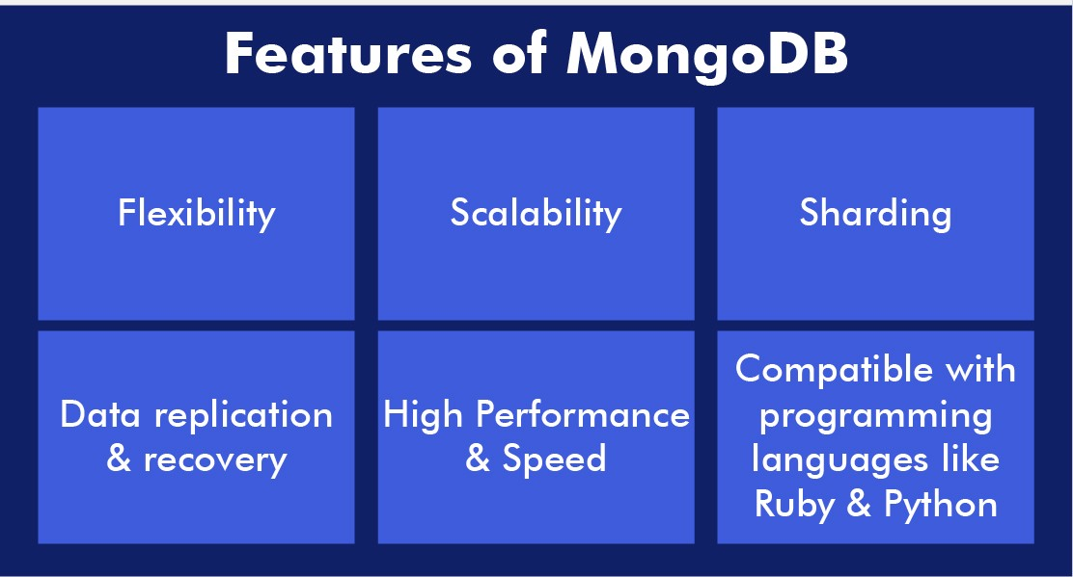
MongoDB fundamentals
Features
Flexible and Dynamic Schema
Rich Query Language
Multi-Document ACID Transactions
High Performance
High Availability
Scalability
Image Source: https://blockchainsimplified.com/blog/mongodb-introduction/mongodb-introduction-features.jpg
Notes:
Left (White Color space):
Title - Parent Topic
Subtitle - Subtopic 1
Body Text - Description in bullets
Right (Grey Color Space):
Body Text - Relevant image (with source)/code snippet
Put reference links in Speaker Notes
Reference:
https://www.tutorialspoint.com/internet_technologies/internet_overview.htm/

Slide 21
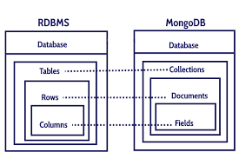
MongoDB fundamentals
Advantages of MongoDB over RDBMS
Schema less.
Structure of a single object is clear.
No complex joins.
Deep query-ability.
Tuning.
Image Source: https://blockchainsimplified.com/blog/mongodb-introduction/mongodb-introduction-features.jpg
Notes:
Left (White Color space):
Title - Parent Topic
Subtitle - Subtopic 1
Body Text - Description in bullets
Right (Grey Color Space):
Body Text - Relevant image (with source)/code snippet
Put reference links in Speaker Notes
Reference:
https://www.tutorialspoint.com/internet_technologies/internet_overview.htm/

Slide 22
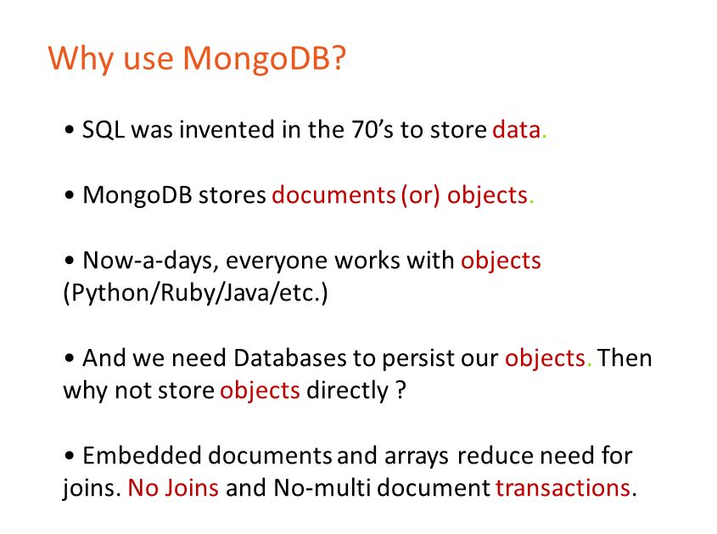
MongoDB fundamentals
Why Use MongoDB?
Document Oriented Storage
Index on any attribute
Replication and high availability
Auto-Sharding
Rich queries
Fast in-place updates
Professional support by MongoDB
Image Source: https://images.slideplayer.com/32/9859102/slides/slide_4.jpg
Notes:
Left (White Color space):
Title - Parent Topic
Subtitle - Subtopic 1
Body Text - Description in bullets
Right (Grey Color Space):
Body Text - Relevant image (with source)/code snippet
Put reference links in Speaker Notes
Reference:
https://www.tutorialspoint.com/internet_technologies/internet_overview.htm/

Slide 23
MongoDB fundamentals
Where to Use MongoDB?
Big Data
Content Management and Delivery
Mobile and Social Infrastructure
User Data Management
Data Hub
Image Source: https://intellipaat.com/blog/wp-content/uploads/2015/08/img-1.jpg
Notes:
Left (White Color space):
Title - Parent Topic
Subtitle - Subtopic 1
Body Text - Description in bullets
Right (Grey Color Space):
Body Text - Relevant image (with source)/code snippet
Put reference links in Speaker Notes
Reference:
https://www.tutorialspoint.com/internet_technologies/internet_overview.htm/

Slide 24
MongoDB fundamentals
Type | Description | Number
Double | Represents a float value. | 1
String | BSON4 strings are UTF-8. In general, drivers for each programming language convert from the language’s string format to UTF-8 when serializing and deserializing BSON. This makes it possible to store most international characters in BSON strings with ease. [1] In addition, MongoDB $regex queries support UTF-8 in the regex string. | 2
Object | Represents an embedded document. | 3
Data Types
MongoDB stores documents on disk in the BSON serialization format. BSON is a binary representation of JSON documents, though BSON data format provides more data types than JSON.
Notes:
Left (White Color space):
Title - Parent Topic
Subtitle - Subtopic 1
Body Text - Description in bullets
Right (Grey Color Space):
Body Text - Relevant image (with source)/code snippet
Put reference links in Speaker Notes
Reference:
https://www.tutorialspoint.com/internet_technologies/internet_overview.htm/

Slide 25
MongoDB fundamentals
Array | Sets or lists of values can be represented as arrays: | 4
Binary data | Binary data is a string of arbitrary bytes, it cannot be manipulated from the shell. | 5
Object id | ObjectIds (MongoDB document identifier, equivalent to a Primary key) are: small, likely unique, fast to generate, and ordered. These values consists of 12-bytes, where the first four bytes are a timestamp that reflect the ObjectId’s creation. ordered. These values consists of 12-bytes, where the first four bytes are a timestamp that reflect the ObjectId’s creation. | 7
Data Types
The mongo JavaScript shell and the MongoDB language drivers translate between BSON and the language-specific document representation.
Notes:
Left (White Color space):
Title - Parent Topic
Subtitle - Subtopic 1
Body Text - Description in bullets
Right (Grey Color Space):
Body Text - Relevant image (with source)/code snippet
Put reference links in Speaker Notes
Reference:
https://www.tutorialspoint.com/internet_technologies/internet_overview.htm/

Slide 26
Introduction to Internet, Browsing, and Emailing
Boolean | A logical true or false. Use to evaluate whether a condition is true or false | 8
Date | BSON Date is a 64-bit integer that represents the number of milliseconds since the Unix epoch (Jan 1, 1970). This results in a representable date range of about 290 million years into the past and future. | 9
Null | It represents both a null value and a nonexistent field. | 10
Regular Expression | RegExp maps directly to a Javascript RegExp | 11
JavaScript |  | 13
Data Types
BSON supports the following data types as values in documents.
Notes:
This slide talks about the case if we have to divide a subtopic further.
Title Box - Parent Topic
Subtitle box - Sub Topic
Body Text - Subtopic divisions (Subtopics of subtopics)

Slide 27
Introduction to Internet, Browsing, and Emailing
Symbol | Not supported by the shell. If the shell gets a symbol from the database, it will convert it into a string. | 14
JavaScript |  | 15
32-bit integer | Numbers without decimal points will be saved as 32-bit integers. | 16
Timestamp | BSON has a special timestamp type for internal MongoDB use and is not associated with the regular Date type. Timestamp values are a 64 bit value where : the first 32 bits are a time_t value (seconds since the Unix epoch). the second 32 bits are an incrementing ordinal for operations within a given second.
Data Types
Each data type has a corresponding number (an integer ID number from 1 to 255) that can be used with the $type operator to query documents by BSON type.
Notes:
This slide talks about the case if we have to divide a subtopic further.
Title Box - Parent Topic
Subtitle box - Sub Topic
Body Text - Subtopic divisions (Subtopics of subtopics)

Slide 28
Introduction to Internet, Browsing, and Emailing
64-bit integer | Numbers without a decimal point will be saved and returned as 64-bit integers. | 18
Min key | MinKey compare less than all other possible BSON element values, respectively, and exist primarily for internal use. | 255
Max key | MaxKey compare greater than all other possible BSON element values, respectively, and exist primarily for internal use. | 127
Data Types
Each data type has a corresponding number (an integer ID number from 1 to 255) that can be used with the $type operator to query documents by BSON type.
Notes:
This slide talks about the case if we have to divide a subtopic further.
Title Box - Parent Topic
Subtitle box - Sub Topic
Body Text - Subtopic divisions (Subtopics of subtopics)

Slide 29
Introduction to Internet, Browsing, and Emailing
Data Types
Order | Data Types
1 | MinKey (internal type)
2 | Null
3 | Numbers (ints, longs, doubles)
4 | Symbol, String
5 | Object
6 | Array
7 | BinData
8 | ObjectId
Comparing values of different BSON types
When comparing values of different BSON types, MongoDB uses the following comparison order, from lowest to highest:
Notes:
This slide talks about the case if we have to divide a subtopic further.
Title Box - Parent Topic
Subtitle box - Sub Topic
Body Text - Subtopic divisions (Subtopics of subtopics)

Slide 30
Introduction to Internet, Browsing, and Emailing
Order | Data Types
1 | MinKey (internal type)
2 | Null
3 | Numbers (ints, longs, doubles)
4 | Symbol, String
5 | Object
6 | Array
7 | BinData
8 | ObjectId
9 | Boolean
10 | Date, Timestamp
11 | Regular Expression
12 | MaxKey (internal type)
Data Types
Comparing values of different BSON types
When comparing values of different BSON types, MongoDB uses the following comparison order, from lowest to highest:
Notes:
This slide talks about the case if we have to divide a subtopic further.
Title Box - Parent Topic
Subtitle box - Sub Topic
Body Text - Subtopic divisions (Subtopics of subtopics)

Slide 31
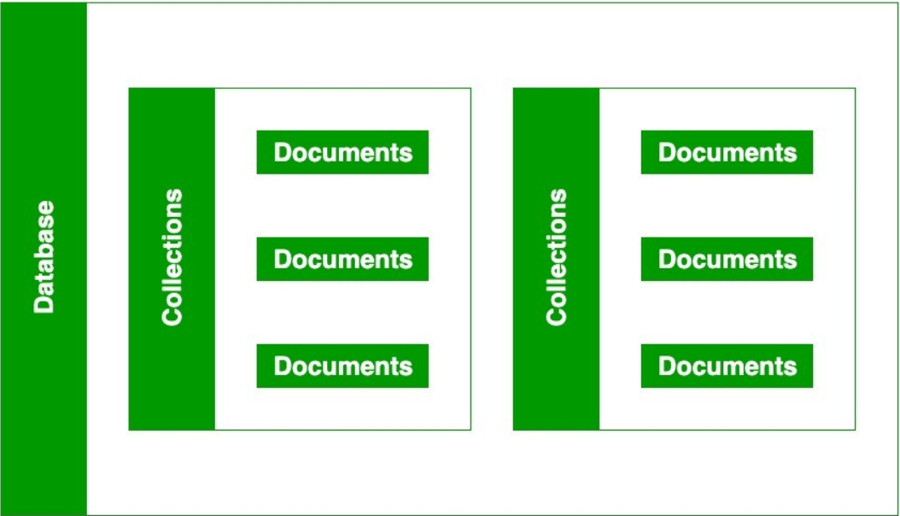
MongoDB documents, databases, Collections
Databases
For storing data in a MongoDB, you need to create a database first. It will allow you to systematically organize your data so that it can be retrieved as per requirement. If you wish to delete a database, MongoDB also allows you to delete that.
In this chapter, you will learn how to create and delete a database in MongoDB.
Image: https://media.geeksforgeeks.org/wp-content/uploads/20200219180521/MongoDB-database-colection.png
Notes:
This slide talks about the case if we have to divide a subtopic further.
Title Box - Parent Topic
Subtitle box - Sub Topic
Body Text - Subtopic divisions (Subtopics of subtopics)

Slide 32
MongoDB documents, databases, Collections
Databases
For storing data in a MongoDB, you need to create a database first. It will allow you to systematically organize your data so that it can be retrieved as per requirement. If you wish to delete a database, MongoDB also allows you to delete that.
In this chapter, you will learn how to create and delete a database in MongoDB.
Image: https://media.geeksforgeeks.org/wp-content/uploads/20200219180521/MongoDB-database-colection.png
Notes:
This slide talks about the case if we have to divide a subtopic further.
Title Box - Parent Topic
Subtitle box - Sub Topic
Body Text - Subtopic divisions (Subtopics of subtopics)

Slide 33
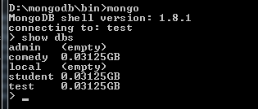
MongoDB documents, databases, Collections
Databases
"show dbs" command provides you with a list of all the databases.
Image: Reference: https://www.w3resource.com/w3r_images/show-dbs-command.png
Notes:
This slide talks about the case if we have to divide a subtopic further.
Title Box - Parent Topic
Subtitle box - Sub Topic
Body Text - Subtopic divisions (Subtopics of subtopics)

Slide 34

Databases
Run the list of Databases in MongoDB
Run 'db' command to refer to the current database object or connection.
Image: Reference: https://www.w3resource.com/w3r_images/db-command.png
Notes:
This slide talks about the case if we have to divide a subtopic further.
Title Box - Parent Topic
Subtitle box - Sub Topic
Body Text - Subtopic divisions (Subtopics of subtopics)

Slide 35

MongoDB documents, databases, Collections
Databases
“use” command for creating database in MsongoDB
You can make use of the "use" command followed by the database_name for creating a database.
Image: Reference: https://www.w3resource.com/w3r_images/use-command.png
Notes:
This slide talks about the case if we have to divide a subtopic further.
Title Box - Parent Topic
Subtitle box - Sub Topic
Body Text - Subtopic divisions (Subtopics of subtopics)

Slide 36
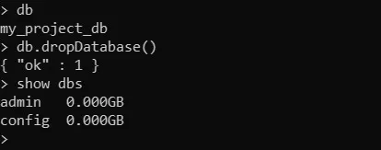
MongoDB documents, databases, Collections
Databases
Deleting a Database in MongoDB
If you are familiar with SQL, then you must have heard about the drop command. The concept of drop in SQL is used to delete the entire database or just the table
Image: Reference: https://www.w3schools.in/wp-content/uploads/2019/06/mongodb_drop_database_
command-1.jpg?ezimgfmt=rs:414x163/rscb7/ng:webp/ngcb7
Notes:
This slide talks about the case if we have to divide a subtopic further.
Title Box - Parent Topic
Subtitle box - Sub Topic
Body Text - Subtopic divisions (Subtopics of subtopics)

Slide 37
MongoDB documents, databases, Collections
Documents
RDBMS | MongoDB
Table | Collection
Column | Key
Value | Value
Records / Rows | Document / Object
The document is the unit of storing data in a MongoDB database.
document use JSON style for storing data.
A simple example of a JSON document is as follows
{ site : "w3resource.com"
Often, the term "object" is used to refer a document.
Notes:
This slide talks about the case if we have to divide a subtopic further.
Title Box - Parent Topic
Subtitle box - Sub Topic
Body Text - Subtopic divisions (Subtopics of subtopics)

Slide 38
MongoDB documents, databases, Collections
Documents
Data Types | Description
string | May be an empty string or a combination of characters.
integer | Digits.
boolean | Logical values True or False.
double | A type of floating point number.
null | Not zero, not empty.
array | A list of values.
object | An entity which can be used in programming. May be a value, variable, function, or data structure.
The following table shows the various datatypes which may be used in MongoDB.
Notes:
This slide talks about the case if we have to divide a subtopic further.
Title Box - Parent Topic
Subtitle box - Sub Topic
Body Text - Subtopic divisions (Subtopics of subtopics)

Slide 39
MongoDB documents, databases, Collections
timestamp | A 64 bit value referring to a time and unique on a single "mongod" instance. The first 32 bit of this value refers to seconds since the UTC January 1, 1970. And last 32 bits refer to the incrementing ordinal for operations within a given second.
Internationalized Strings | UTF-8 for strings.
Object IDs | Every MongoDB object or document must have an Object ID which is unique. This is a BSON object id, a 12-byte binary value which has a very rare chance of getting duplicated.
Documents
The following table shows the various datatypes which may be used in MongoDB.
Notes:
This slide talks about the case if we have to divide a subtopic further.
Title Box - Parent Topic
Subtitle box - Sub Topic
Body Text - Subtopic divisions (Subtopics of subtopics)

Slide 40
MongoDB documents, databases, Collections
Collections
A collection may store a number of documents.
A collection is analogous to a table of an RDBMS.
A collection may store documents those who are not same in structure.
This is possible because MongoDB is a Schema-free database.
Image: https://media.geeksforgeeks.org/wp-content/uploads/20200219180521/MongoDB-database-colection.png
Notes:
This slide talks about the case if we have to divide a subtopic further.
Title Box - Parent Topic
Subtitle box - Sub Topic
Body Text - Subtopic divisions (Subtopics of subtopics)

Slide 41
MongoDB documents, databases, Collections
Collections
In the following code, it is shown that two MongoDB documents, belongs to same collection, storing data of different structures.
{"tutorial" : "NoSQL"}
{"topic_id" : 7}
A collection is created, when the first document is inserted.
Image: https://media.geeksforgeeks.org/wp-content/uploads/20200219180521/MongoDB-database-colection.png
Notes:
This slide talks about the case if we have to divide a subtopic further.
Title Box - Parent Topic
Subtitle box - Sub Topic
Body Text - Subtopic divisions (Subtopics of subtopics)

Slide 42
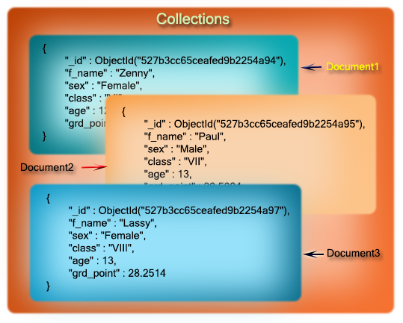
Collections
Valid collection names
Collection names must begin with letters or an underscore.
A Collection name may contain numbers
You can't use "$" character within the name of a collection. "$" is reserved.
A Collection name must not exceed 128 characters.
Using a "." (dot) notation, collections can be organized in named groups.
Image: https://www.w3resource.com/w3r_images/mongodb-document-collection.png
Notes:
This slide talks about the case if we have to divide a subtopic further.
Title Box - Parent Topic
Subtitle box - Sub Topic
Body Text - Subtopic divisions (Subtopics of subtopics)

Slide 43
Collections
Valid collection names
Following is how to use it programmatically:
db.tutorials.php.findOne()
Image: https://www.w3resource.com/w3r_images/mongodb-document-collection.png
Notes:
This slide talks about the case if we have to divide a subtopic further.
Title Box - Parent Topic
Subtitle box - Sub Topic
Body Text - Subtopic divisions (Subtopics of subtopics)

Slide 44

MongoDB Atlas cluster
MongoDB Atlas
MongoDB Atlas is the DBaaS offering from MongoDB Inc. It allows you to provision a database on the cloud as a service, which can be used for your applications from anywhere.
Atlas uses cloud infrastructures from different cloud vendors. You can choose the cloud vendor on which you want to deploy your database.
Image: https://techcrunch.com/wp-content/uploads/2016/06/2016-06-27_1940.png
Notes:
This slide talks about the case if we have to divide a subtopic further.
Title Box - Parent Topic
Subtitle box - Sub Topic
Body Text - Subtopic divisions (Subtopics of subtopics)

Slide 45
MongoDB Atlas cluster
MongoDB Atlas Benefits
Simple Setup
Guaranteed Availability
Global Presence
Optimal Performance
Highly Secured
Automated Backups
Image: https://techcrunch.com/wp-content/uploads/2016/06/2016-06-27_1940.png
Notes:
This slide talks about the case if we have to divide a subtopic further.
Title Box - Parent Topic
Subtitle box - Sub Topic
Body Text - Subtopic divisions (Subtopics of subtopics)

Slide 46
MongoDB Atlas cluster
Advantages of MongoDB Atlas
Global clusters for world-class applications
Secure for sensitive data
Designed for developer productivity
Reliable for mission-critical workload
Built for optimal performance
Managed for operational efficiency
Image: https://techcrunch.com/wp-content/uploads/2016/06/2016-06-27_1940.png
Notes:
This slide talks about the case if we have to divide a subtopic further.
Title Box - Parent Topic
Subtitle box - Sub Topic
Body Text - Subtopic divisions (Subtopics of subtopics)

Slide 47
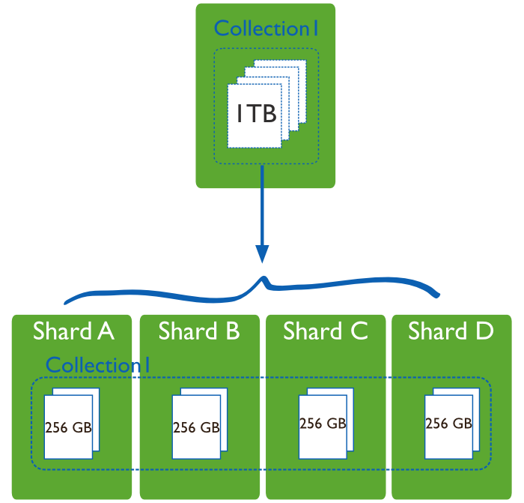
MongoDB Atlas cluster
What are clusters in MongoDB
In the context of MongoDB, “cluster” is the word usually used for either a replica set or a sharded cluster.
A replica set is the replication of a group of MongoDB servers that hold copies of the same data.
A sharded cluster is also commonly known as horizontal scaling, where data is distributed across many servers.
Image: https://i.stack.imgur.com/zCOvb.png
Notes:
This slide talks about the case if we have to divide a subtopic further.
Title Box - Parent Topic
Subtitle box - Sub Topic
Body Text - Subtopic divisions (Subtopics of subtopics)

Slide 48
MongoDB Atlas cluster
What is MongoDB Atlas Cluster?
MongoDB Atlas Cluster is a NoSQL Database-as-a-Service offering in the public cloud (available in Microsoft Azure, Google Cloud Platform, Amazon Web Services). This is a managed MongoDB service, and with just a few clicks, you can set up a working MongoDB cluster, accessible from your favorite web browser.
Image: https://i.stack.imgur.com/zCOvb.png
Notes:
This slide talks about the case if we have to divide a subtopic further.
Title Box - Parent Topic
Subtitle box - Sub Topic
Body Text - Subtopic divisions (Subtopics of subtopics)

Slide 49
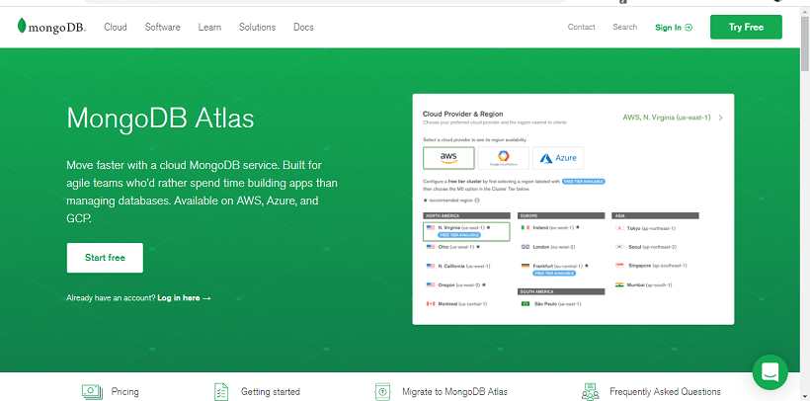
MongoDB Atlas cluster connection and access remotely
Create an Atlas Account and deploying a Free Tier Cluster
Step 1: Go to https://www.mongodb.com/cloud/atlas
to register for an Atlas account to host your data
Image: https://static.javatpoint.com/mongodb/images/mongodb-atlas1.png
Notes:
This slide talks about the case if we have to divide a subtopic further.
Title Box - Parent Topic
Subtitle box - Sub Topic
Body Text - Subtopic divisions (Subtopics of subtopics)

Slide 50
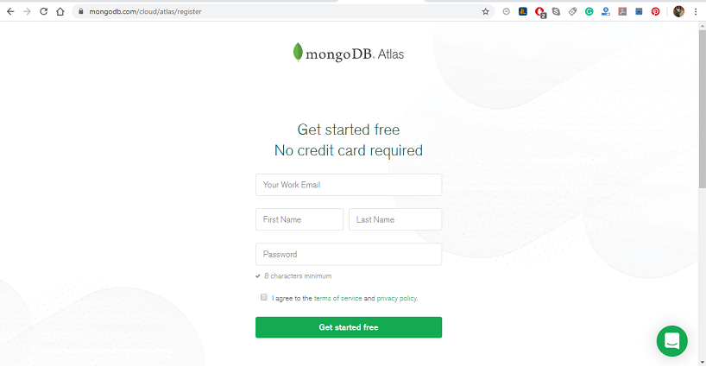
MongoDB Atlas cluster connection and access remotely
Create an Atlas Account and deploying a Free Tier Cluster
Step 2: When you click on Start Free, you will be redirected to the Registration form for an account on the MongoDB Atlas.
Image: https://static.javatpoint.com/mongodb/images/mongodb-atlas1.png
Notes:
This slide talks about the case if we have to divide a subtopic further.
Title Box - Parent Topic
Subtitle box - Sub Topic
Body Text - Subtopic divisions (Subtopics of subtopics)

Slide 51
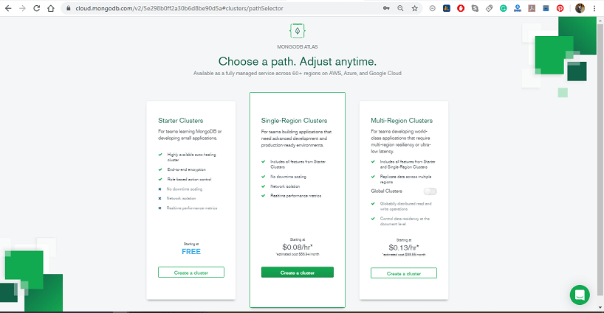
MongoDB Atlas cluster connection and access remotely
Create an Atlas Account and deploying a Free Tier Cluster
Step 3: Select Starter Clusters and click create a Cluster. The Starter cluster includes the M0, M2, and M5 cluster tiers. These low-cost clusters are suitable for users who are learning MongoDB or developing small proof -of- concept applications.
Image: https://static.javatpoint.com/mongodb/images/mongodb-atlas1.png
Notes:
This slide talks about the case if we have to divide a subtopic further.
Title Box - Parent Topic
Subtitle box - Sub Topic
Body Text - Subtopic divisions (Subtopics of subtopics)

Slide 52
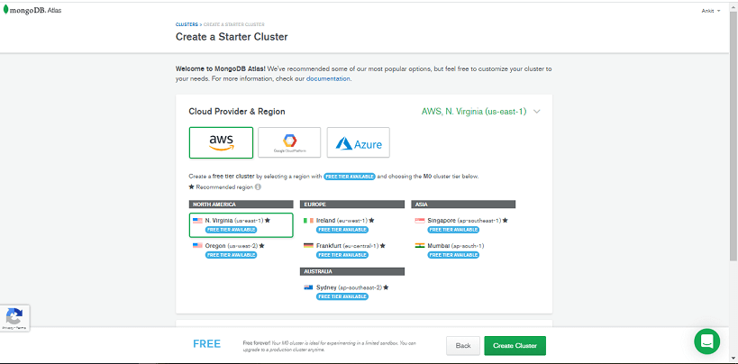
MongoDB Atlas cluster connection and access remotely
Create an Atlas Account and deploying a Free Tier Cluster
Step 4: Select your preferred Cloud Provider & Region. It supports M0 Free Tier clusters on Amazon Web Services (AWS), Google Cloud Platform (GCP), and Microsoft Azure. The regions that support M0 Free tier clusters are marked with the "Free Tier Available" label.
Image: https://static.javatpoint.com/mongodb/images/mongodb-atlas1.png
Notes:
This slide talks about the case if we have to divide a subtopic further.
Title Box - Parent Topic
Subtitle box - Sub Topic
Body Text - Subtopic divisions (Subtopics of subtopics)

Slide 53
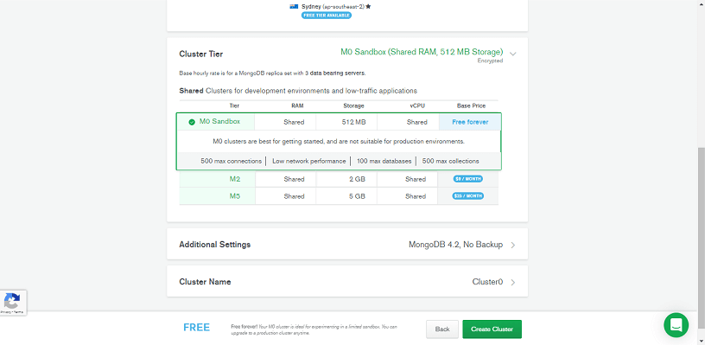
MongoDB Atlas cluster connection and access remotely
Create an Atlas Account and deploying a Free Tier Cluster
Step 5: Select M0 Sandbox for cluster tier: Selecting M0 automatically locks the remaining configuration options. If you can't select the M0 cluster tier, return to the previous step and choose a Cloud Provider & Region that supports M0 Free Tier clusters.
Image: https://static.javatpoint.com/mongodb/images/mongodb-atlas1.png
Notes:
This slide talks about the case if we have to divide a subtopic further.
Title Box - Parent Topic
Subtitle box - Sub Topic
Body Text - Subtopic divisions (Subtopics of subtopics)

Slide 54
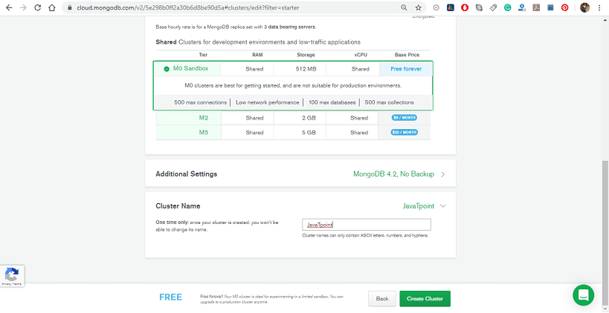
MongoDB Atlas cluster connection and access remotely
Create an Atlas Account and deploying a Free Tier Cluster
Step 6: Enter a name for your cluster in the Cluster Name field; you can enter any name for your cluster. The cluster name contains ASCII letters, numbers, and hyphens.
Image: https://static.javatpoint.com/mongodb/images/mongodb-atlas1.png
Notes:
This slide talks about the case if we have to divide a subtopic further.
Title Box - Parent Topic
Subtitle box - Sub Topic
Body Text - Subtopic divisions (Subtopics of subtopics)

Slide 55
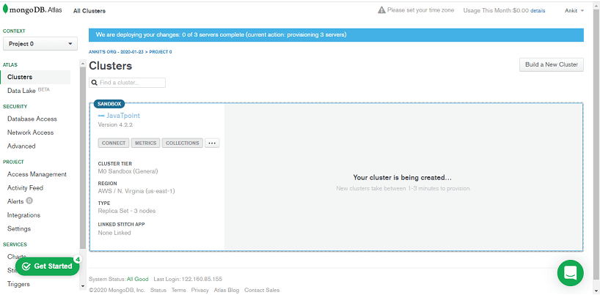
MongoDB Atlas cluster connection and access remotely
Create an Atlas Account and deploying a Free Tier Cluster
Step 7: Click on Create Cluster to deploy the cluster. Once you deploy your cluster, it can take up to 5-10 min for your cluster to provision and become ready to use.
Image: https://static.javatpoint.com/mongodb/images/mongodb-atlas1.png
Notes:
This slide talks about the case if we have to divide a subtopic further.
Title Box - Parent Topic
Subtitle box - Sub Topic
Body Text - Subtopic divisions (Subtopics of subtopics)

Slide 56
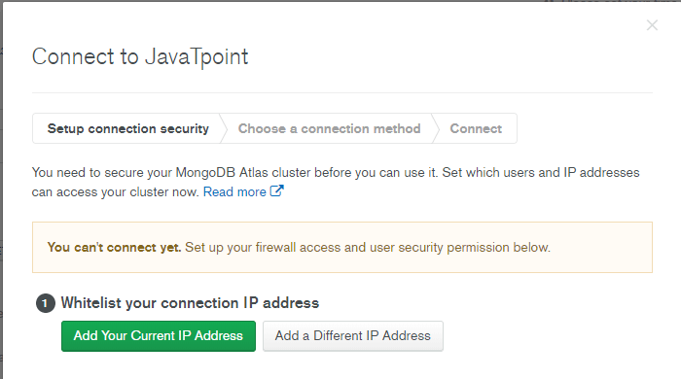
MongoDB Atlas cluster connection and access remotely
Create an Atlas Account and deploying a Free Tier Cluster
Step 8: Once we register, Atlas automatically creates a default organization and project where we can deploy our first cluster. We can add additional organizations and projects later.
Image: https://static.javatpoint.com/mongodb/images/mongodb-atlas1.png
Notes:
This slide talks about the case if we have to divide a subtopic further.
Title Box - Parent Topic
Subtitle box - Sub Topic
Body Text - Subtopic divisions (Subtopics of subtopics)

Slide 57
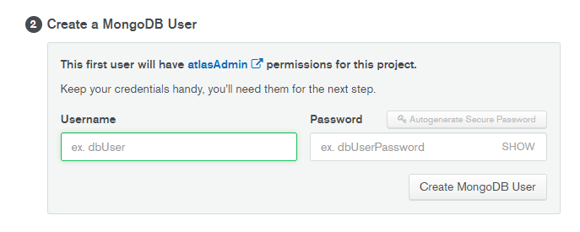
MongoDB Atlas cluster connection and access remotely
How to Whitelist your Connection IP Address
Step 1: First, click on the Connect button from our cluster view.
Step 2: Configure your Whitelist entry. In the Whitelist your connection IP address step, click Add our Current IP Address.
Step 3: Click Add IP Address.
Image: https://static.javatpoint.com/mongodb/images/mongodb-atlas2.png
Notes:
This slide talks about the case if we have to divide a subtopic further.
Title Box - Parent Topic
Subtitle box - Sub Topic
Body Text - Subtopic divisions (Subtopics of subtopics)

Slide 58
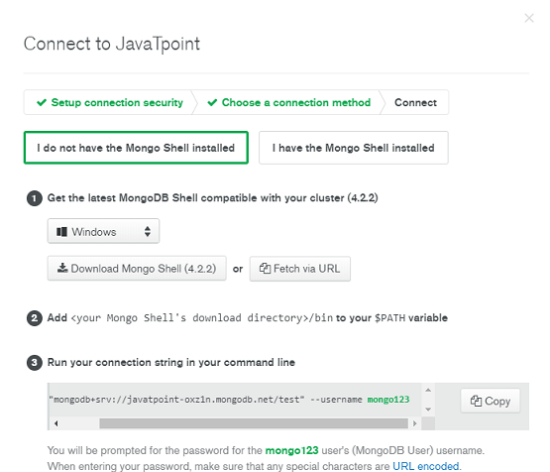
MongoDB Atlas cluster connection and access remotely
Creating a MongoDB User for our Cluster
Step 1: Open the Connect dialogue from our Cluster view.
Step 2: In the Create a MongoDB User step of the dialog, enter a Username and a password for our MongoDB user.
Step 3: Finally, click on Create MongoDB User button.
Image: https://static.javatpoint.com/mongodb/images/mongodb-atlas2.png
Notes:
This slide talks about the case if we have to divide a subtopic further.
Title Box - Parent Topic
Subtitle box - Sub Topic
Body Text - Subtopic divisions (Subtopics of subtopics)

Slide 59
MongoDB Atlas cluster connection and access remotely
Connecting to Cluster
We can connect to our cluster in several ways. We will see how we can connect our cluster using the mongo shell driver.
Following are the steps to download and install the mongo shell driver.
Step 1: Open the Connect dialog from your cluster.
Image: https://static.javatpoint.com/mongodb/images/mongodb-atlas2.png
Notes:
This slide talks about the case if we have to divide a subtopic further.
Title Box - Parent Topic
Subtitle box - Sub Topic
Body Text - Subtopic divisions (Subtopics of subtopics)

Slide 60
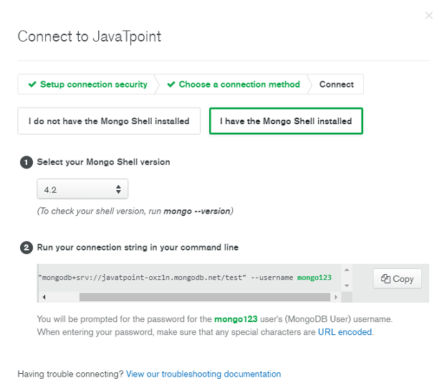
MongoDB Atlas cluster connection and access remotely
Connecting to Cluster
Step 2: Click connect with the Mongo Shell.
Step 3: Click on "I do not have the Mongo Shell installed" and select your operating system from the dropdown.
Step 4: Click on download the Mongo Shell.
Step 5: To run a Mongo Shell from your PC, you will need to add the Shell to your system path.
Image: https://static.javatpoint.com/mongodb/images/mongodb-atlas2.png
Notes:
This slide talks about the case if we have to divide a subtopic further.
Title Box - Parent Topic
Subtitle box - Sub Topic
Body Text - Subtopic divisions (Subtopics of subtopics)

Slide 61
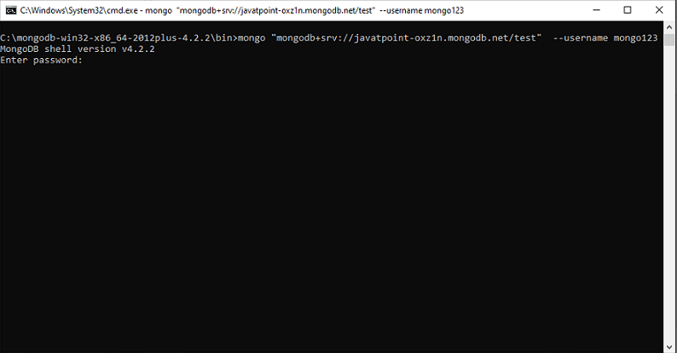
MongoDB Atlas cluster connection and access remotely
Connecting to Cluster
Step 6: To see if you have correctly added the Mongo Shell to your system-path, run the following command in your terminal.
mongo - - version
Image: https://static.javatpoint.com/mongodb/images/mongodb-atlas2.png
Notes:
This slide talks about the case if we have to divide a subtopic further.
Title Box - Parent Topic
Subtitle box - Sub Topic
Body Text - Subtopic divisions (Subtopics of subtopics)

Slide 62
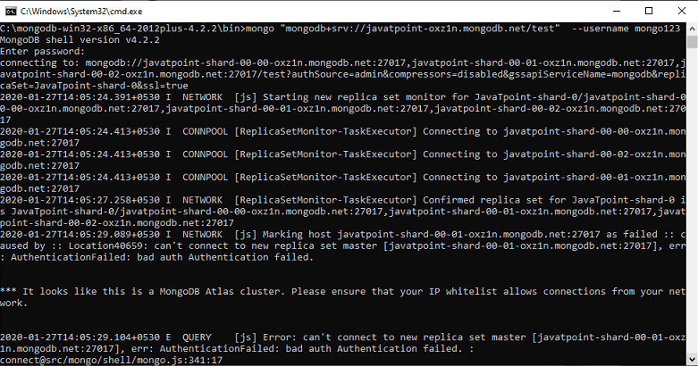
MongoDB Atlas cluster connection and access remotely
Connecting to Cluster
Step 7: Click on "I have the Mongo Shell Installed" and select your Mongo Shell version from the drop-down menu.
Step 8: Now, copy the provided connection string to your clipboard, then paste and run your connection string in your terminal.
Image: https://static.javatpoint.com/mongodb/images/mongodb-atlas2.png
Notes:
This slide talks about the case if we have to divide a subtopic further.
Title Box - Parent Topic
Subtitle box - Sub Topic
Body Text - Subtopic divisions (Subtopics of subtopics)

Slide 63
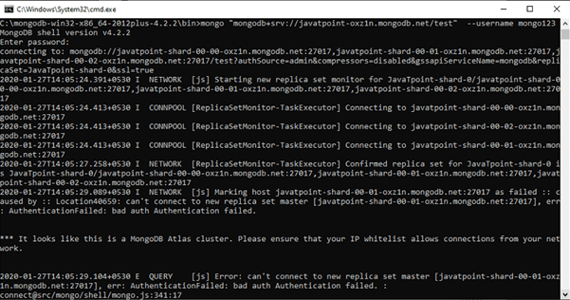
MongoDB Atlas cluster connection and access remotely
Connecting to Cluster
Step 9: Now, you will be prompted to enter the password you specified when you created your MongoDB user in Atlas.
You are now will be connected to your Atlas cluster within the Mongo Shell.
Image: https://static.javatpoint.com/mongodb/images/mongodb-atlas2.png
Notes:
This slide talks about the case if we have to divide a subtopic further.
Title Box - Parent Topic
Subtitle box - Sub Topic
Body Text - Subtopic divisions (Subtopics of subtopics)

